Slide 1
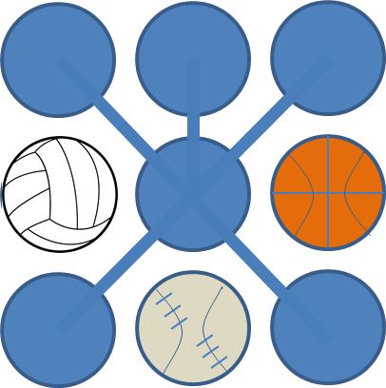
BringTeam
A social app linking community sports teams
To organize its events
Austin, Texas
November, 2016
CONFIDENTIAL

Slide 2
Bringteam
Bringteam is a sports management app to help community teams coordinate their players, fans, games, and practices
It relies on social interaction to post updates and get results
It provides a calendar of events listing location, date, and time to inform ‘users’ on the event’s logistics
It tracks final scores for games and ranks teams within a ‘league/division’
LAST PRIORITY ON BUILD
It allows players to confirm/deny attendance at events so that coaches can organize their game plan and adjust accordingly

Slide 3
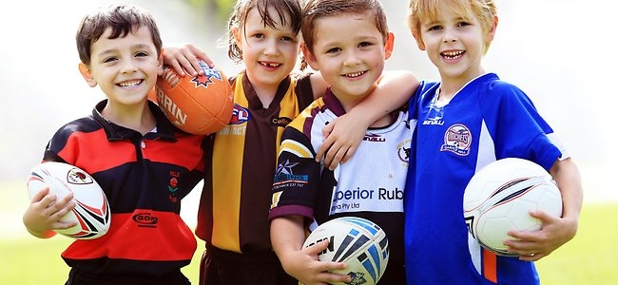

BringTeam
Login
Sign-up
The first step to winning is showing up…
BringTeam is a simple app connecting players, coaches, families, and fans
CONTACTS
RSVP
CALENDAR
STATS

Slide 4
App Work Flow User Swim Lanes
Web Activity
Sports Center
Coach
Player
Family /Fan
Create User –
(tag “SC-manager”)
Create Sports Center
Create Division
Create Team
Create User –
(tag “coach”)
Create Team
Edit Team – Assign Coach
Edit Team – Pick Players
Create/Edit –
Practice
Create/Edit –
Games
Create/Edit –
Tournaments
GET practice
GET game
GET tournament
Create Player
GET team assigned
POST attendance
POST attendance
POST attendance
GET team assigned
GET practice
GET game
GET tournament
Create User –(tag “guardian”)
Create User –(tag “fan”)
GET history

Slide 5
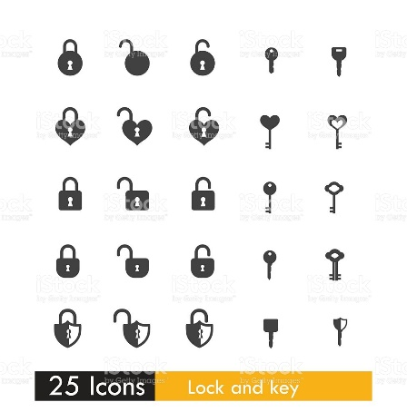
Database Schema
Role
roleId
userId
Role (restricted)
--Guardian
--Fan
--SCManager
--Coach
--asstCoach
--Referee
--Player
sportsCenter
Sc_Id
Sc-managerId
Name
Location
Telephone
Division
divisionId
Name
sport
Sc_id
seasonStart
seasonEnd
user
userId
Name
Telephone
enrolllDate
Email
username
password
event
eventId
Name
Date
startTime
endTime
Type
Team1
Team2
ScoreTeam1
ScoreTeam2
team
teamId
divisionId
teamName
roleID

Slide 6


Logo design

